Slide 1
EXCEL PROJECT
THIS COMPLETE PROJECT IS ABOUT THE SALES OF THE COMPANY NAME AS BIGMART AND USING THE DATA, CAME UP WITH THE VALUEABLE INSIGHTS IN A DASHBOARD
THIS COMPLETE DATA SET HAS 11 COLUMNS AND TOTAL 1001 ROWS
AND THE FIELDS OR TERMS WHICH THIS DATASET HAS ARE AS FOLLOWS:
ITEM IDENTIFIER, ITEM WEIGHT, ITEM FAT CONTENT, ITEM TYPE, ITEM MRP, OUTLET IDENTIFIER, OUTLET ESTABLISHMENT YEAR, OUTLET SIZE, OUTLET LOCATION TYPE, OUTLET TYPE, ITEM OUTLET SALES, ETC.

Slide 2
QUESTIONS BASED ON DATASET
WHAT IS THE HIGHEST AND LOWEST SALES IN PARTICULAR YEAR?
WHICH ITEM TYPE HAS THE HIGHEST AND LOWEST SALES?
WHAT IS THE MAXIMUM AND MINIMUM ITEM WEIGHT OF A ITEM TYPE?
WHICH TYPE OF OUTLET HAS THE HIGHEST AND LOWEST SALES?
WHAT IS THE TOTAL ITEM MRP WITH RESPECT TO ITEM TYPE?
WHAT IS THE TOTAL COUNT OF FAT CONTENT?
IN WHICH YEAR THE SALES WERE HIGH AND LOW?
WHICH ITEM TYPE HAS THE HIGHEST SALES IN AN OUTLET ESTABLISHMENT YEAR?
WHAT IS THE SALES OF THE OUTLET TYPE ACORDING TO THE OUTLET SIZE?
WHAT IS TOTAL COUNT OF OUTLET TYPE?
WHAT IS THE TOTAL SALES OF PARTICULAR LOCATION

Slide 3
WHAT IS THE HIGHEST AND LOWEST SALES IN PARTICULAR YEAR?
HIGHEST – 461927 IN 1985
LOWEST – 20765 IN 1998

Slide 4
WHICH ITEM TYPE HAS THE HIGHEST AND LOWEST SALES?
HIGHEST - FRUITS AND VEGETABLES
LOWEST - SEAFOOD

Slide 5
WHAT IS THE MAXIMUM AND MINIMUM ITEM WEIGHT OF A ITEM TYPE?
MAXIMUM – 1742
MINIMUM - 34

Slide 6
WHICH TYPE OF OUTLET HAS THE HIGHEST AND LOWEST SALES?
HIGHEST - SUPER MARKET 1
LOWEST - GROCERY STORE

Slide 7
WHAT IS THE TOTAL ITEM MRP WITH RESPECT TO ITEM TYPE?
TOTAL MRP - 138088

Slide 8
WHAT IS THE TOTAL COUNT OF FAT CONTENT?
LOW FAT – 635
REGULAR - 328
LF - 26
REG - 11

Slide 9
IN WHICH YEAR THE SALES WERE HIGH AND LOW?
HIGH – 1985
LOW - 1998

Slide 10
WHICH ITEM TYPE HAS THE HIGHEST SALES IN AN OUTLET ESTABLISHMENT YEAR?
HIGHEST - 186

Slide 11
WHAT IS THE SALES OF THE OUTLET TYPE ACORDING TO THE OUTLET SIZE?
SUPERMARKET TYPE 1 - 1512239
SUPERMARKET TYPE 3 - 442796
SUPERMARKET TYPE 2 - 195710
GROCERY STORE - 39896

Slide 12
WHAT IS TOTAL COUNT OF OUTLET TYPE?
SUPERMARKET TYPE 1 - 655
SUPERMARKET TYPE 3 - 125
GROCERY STORE - 124
SUPERMARKET TYPE 2 - 96

Slide 13
WHAT IS THE TOTAL SALES OF PARTICULAR LOCATION
TIER 3 - 899190
TIER 2 - 765160
TIER 1 - 526291

Slide 14
CONCLUSION
FROM THE DATA SET, IT IS CONFIRM THAT, YEAR 1985 HAS HIGHEST SALES AND 1998 HAS LOWEST SALES
ALSO FRUITS AND VEGETABLES HAVE THE HIGHEST SALES AND SEAFOOD HAS THE LOWEST SALES
THE MAXIMUM WEIGHT OF THE ITEM TYPE IS 1742 AND THE MINIMUM WEIGHT IS 34
ALSO, SUPERMARKET 1 HAS THE HIGHEST SALES AND GROCERY STORE HAS THE LOWEST SALES
THE TOTAL ITEM MRP IS 138088
TOTAL COUNT OF LOW FAT IS 635, REGULAR IS 328, LF IS 26 AND REG IS 11
IN YEAR 1985 THE SALES WERE HIGH, AND IN YEAR 1998 THE SALES WERE LOW
THE HIGHEST COUNT OF THE ITEM SALE IS 186 IN YEAR 1985
THE SUPERMARKET TYPE 1 HAS 1512239 SALES IN ALL OUTLET SIZES
SUPERMARKET TYPE 1 HAS HIGHEST COUNT AND SUPERMAKET TYPE 2 HAS LOWEST COUNT AS 655 AND 96
TIER 3 HAS HIGHEST SALES AND TIER 1 HAS LOWEST SALES

Slide 15
DATA SOURCE
DATA SET
https://www.kaggle.com/uniabhi/bigmart-sales-data?select=Test.csv
VIDEO LINK
https://drive.google.com/file/d/1j5sVbUNKl7377TpQcvsYdFOX4u2mdmGN/view?usp=sharing

Slide 16
INTERACTIVE DASHBOARD

Slide 17
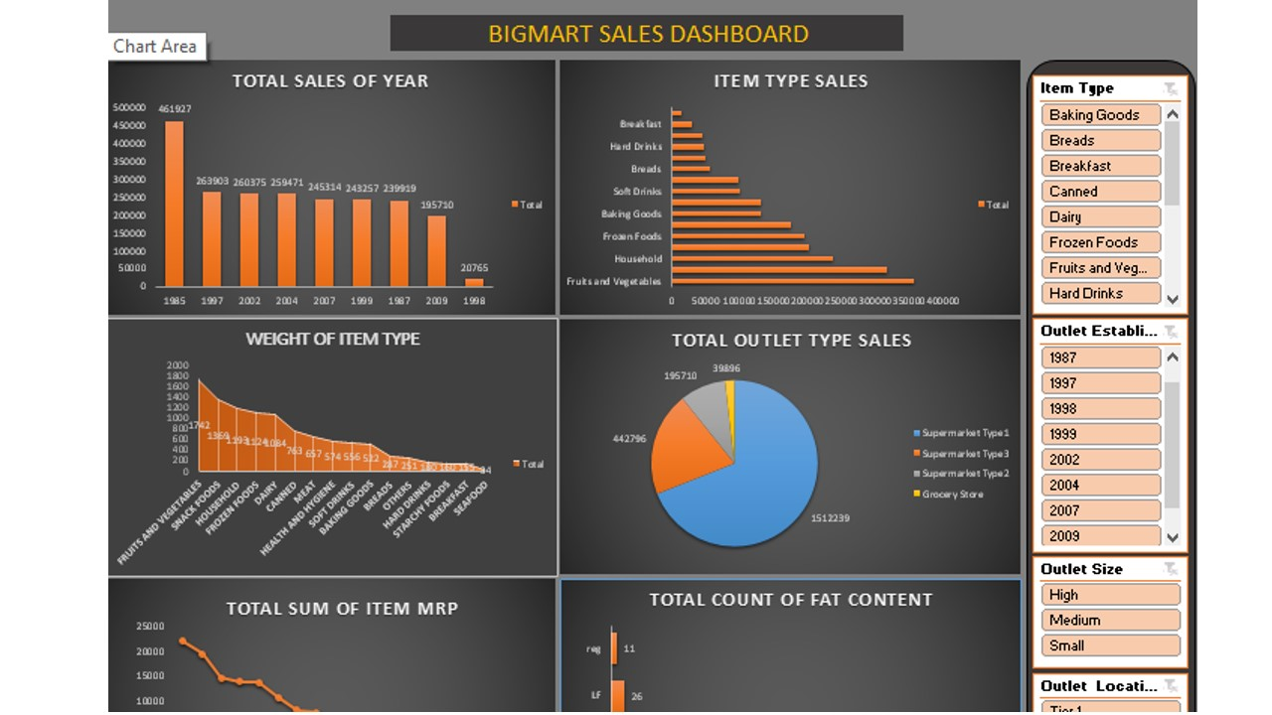

Slide 18
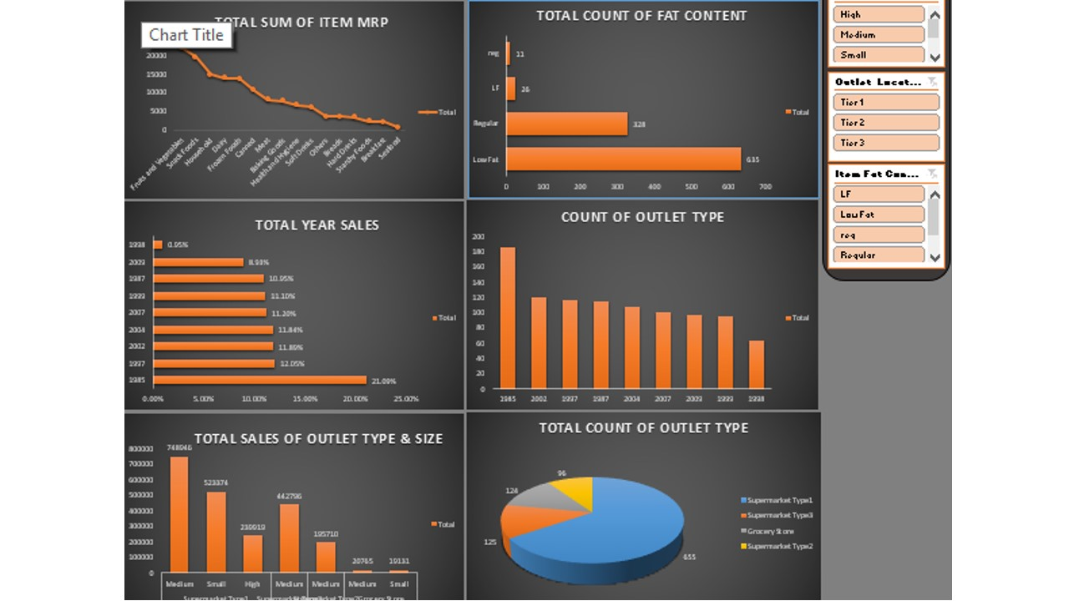

Slide 19
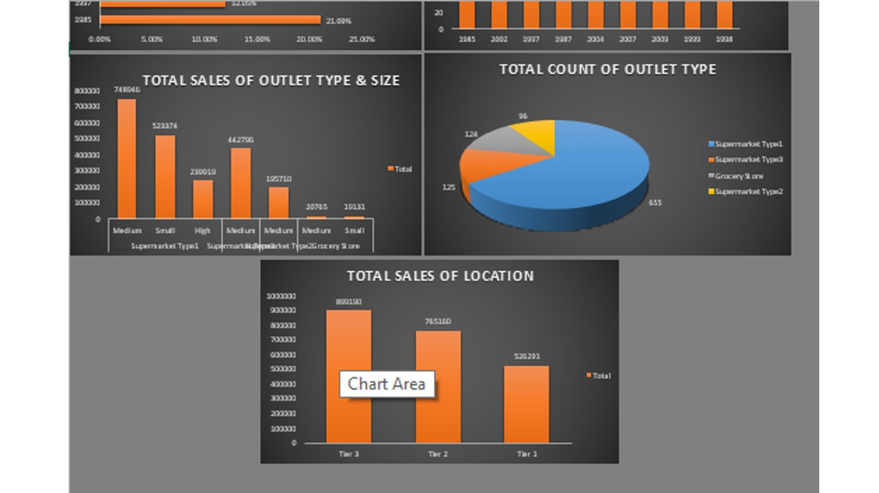

Slide 20
THANK YOU

